Slide 1
FPOM PINNIPED TASK GROUP MEETING
SEA LION MONITORING AT BONNEVILLE DAM:
2018 UPDATES
Kyle Tidwell
Portland District - Fish Field Unit,
Bonneville Lock and Dam
May 24th, 2018

Slide 2
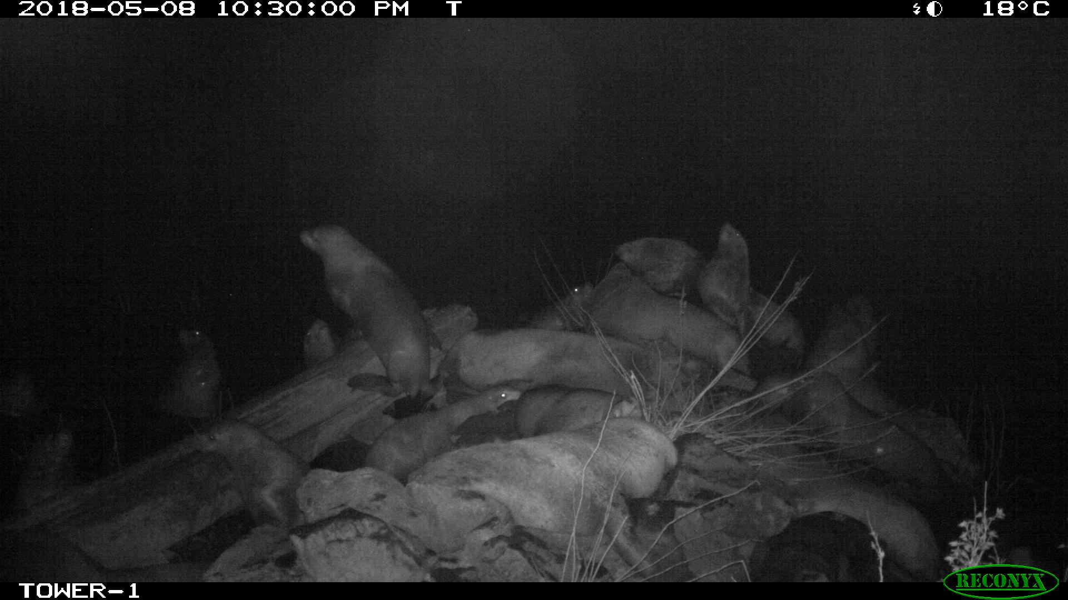
2018: Sea Lion Monitoring Effort
FFU:
Lindsay Magill
Brett Carrothers
Kat Coy
Kristen Bayley
Tim Rivers
Bjorn Van der Leeuw
Patricia Madson
Karrie Gibbons
Nathan Zorich
Darren Gallion
Robert Wertheimer
ODFW:
Shay Valentine
Mike Brown
Bryan Wright
WDFW:
Elliot Johnson
Willy Crowson
Steve Jeffries

Slide 3
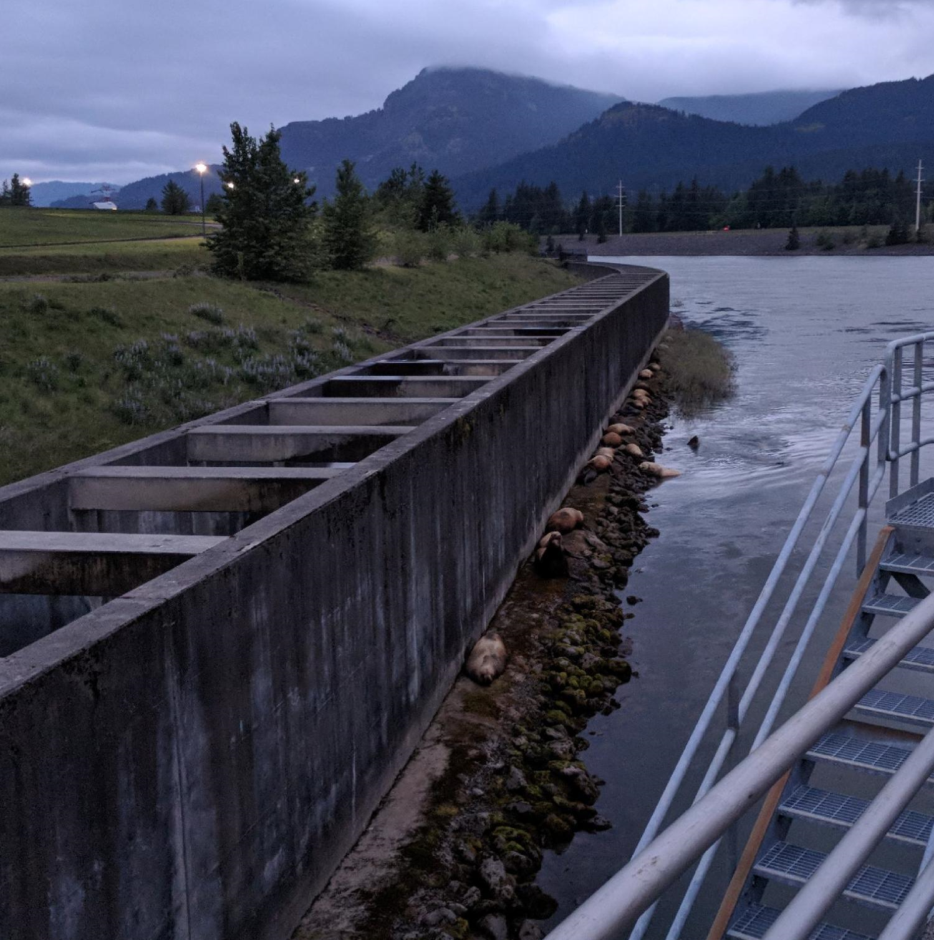
SSL Hauling Out at B2CC

Slide 4
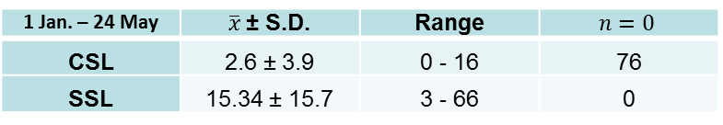
Pinniped Abundance
1 Jan. – 24 May | $\overline{x}$± S.D. | Range | $$n=0$$
CSL | 2.6 ± 3.9 | 0 - 16 | 76
SSL | 15.34 ± 15.7 | 3 - 66 | 0

Slide 5
Fish Predation
Species | Chinook | Steelhead | Sturgeon | Lamprey | Other | Unknown
SSL | 685 | 62 | 45 | 6 | 10 | 101
CSL | 201 | 15 | 1 | 2 | 5 | 39
Total | 886 | 77 | 46 | 8 | 15 | 140
Total
909
263
1172
Observed fish consumption by both species of pinniped at Bonneville Dam from 1 January – 24 May, 2018. Observation samples had an average of 25% coverage of all daylight hours. The numbers will be expanded for unobserved hours and adjusted for “unknown” depredation events.

Slide 6

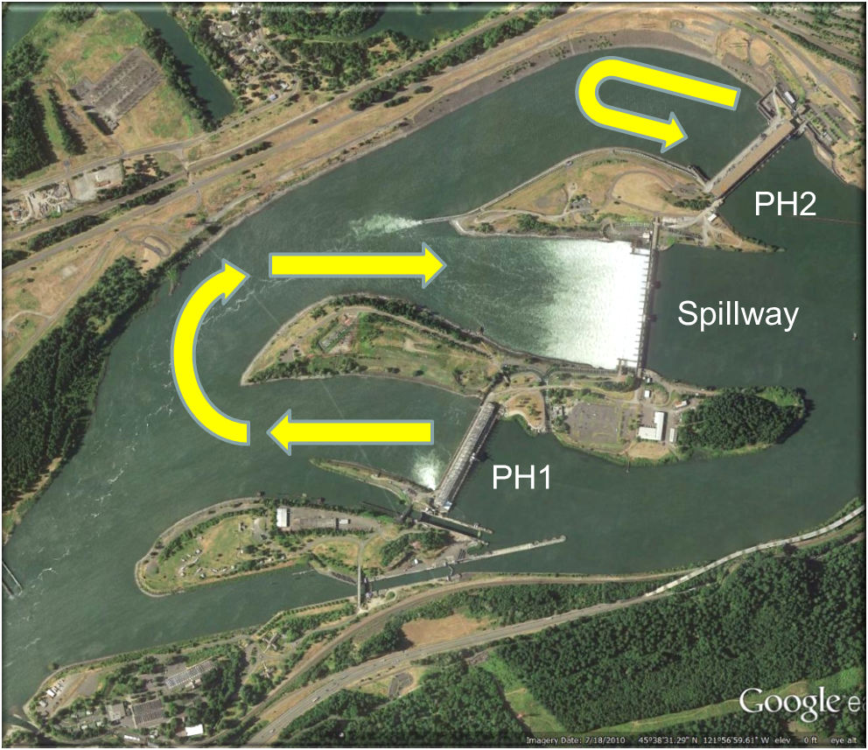
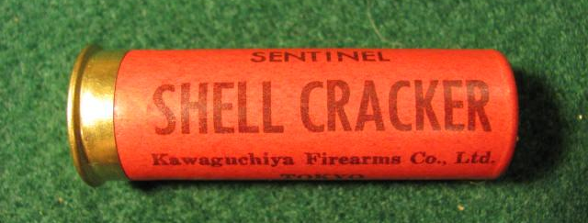
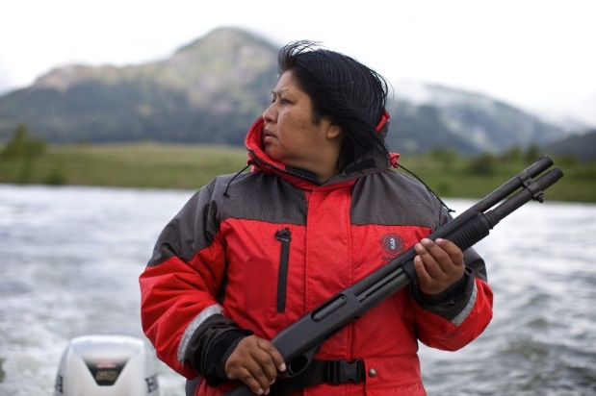
Hazing
Photo Credit: The Oregonian / Thomas Boyd

Slide 7
A Case Study:
Do the current hazing efforts by USDA change the behavior of recurring SSLs at Bonneville Dam?
Does it: change the frequency of foraging?
change the zone where the animals occur?
change the level of vigilance each animal expresses?
&
How do these change with more exposure to hazing and more fish at the dam
(i.e. through out the season)?

Slide 8
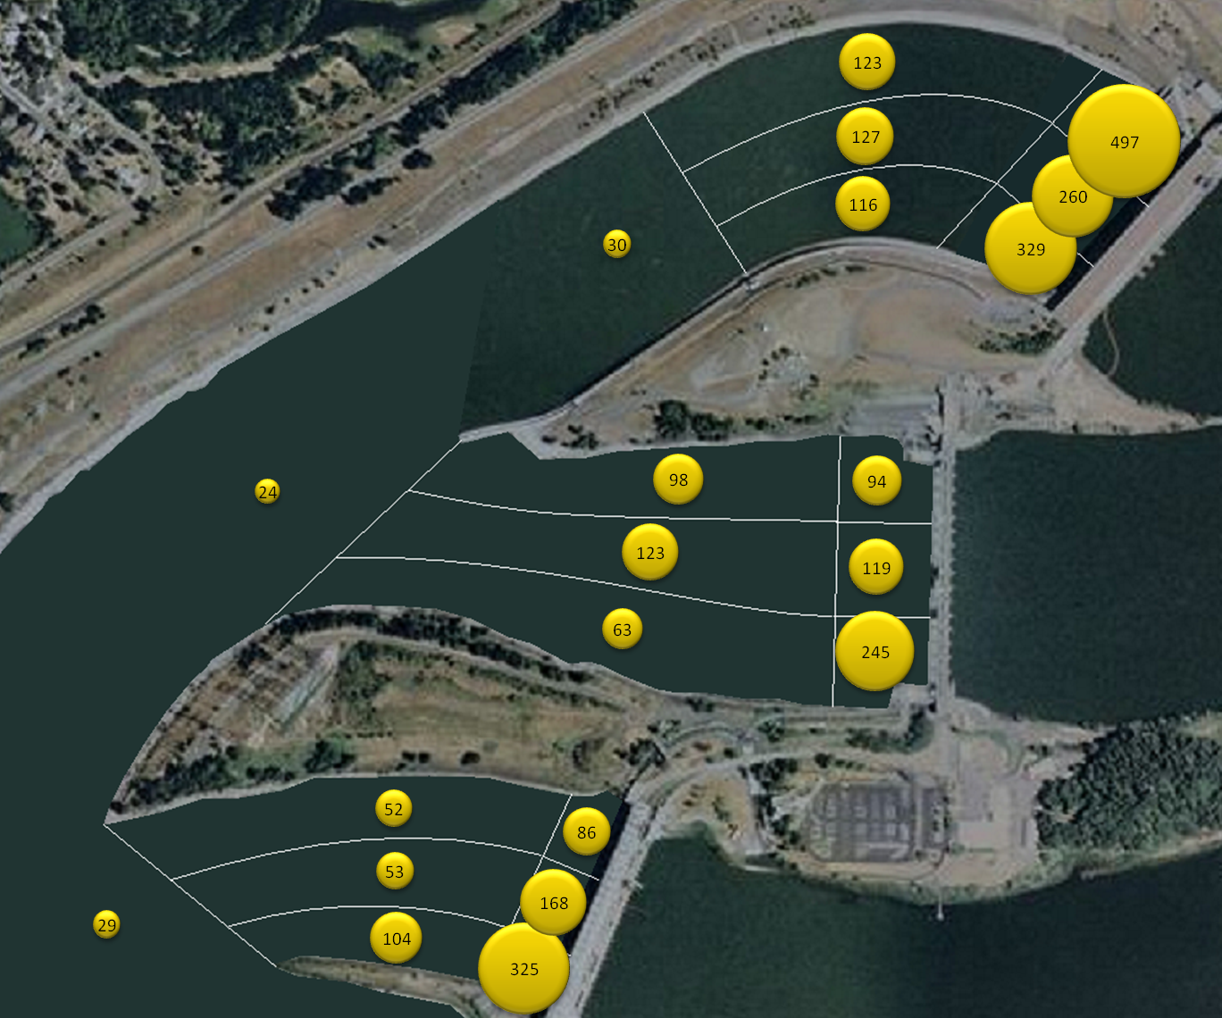
Methodological Approach
Behavior
Zone
Vigilance
SSL Chinook Catch by Location circa 2010

Slide 9

BEHAVIOR
March
April

Slide 10


ZONE
March
April

Slide 11

VIGILANCE
March
April

Slide 12
Fall and Winter Predation Monitoring

Slide 13
Fall and Winter Predation Monitoring

Slide 15
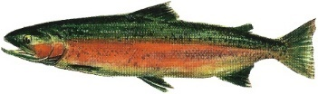
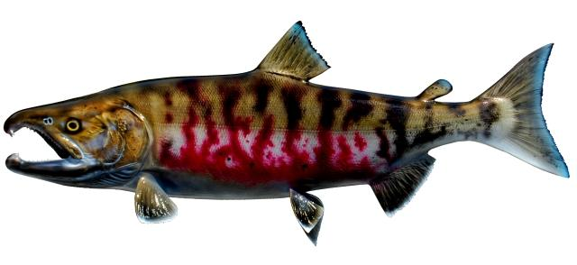
Temporal Expansion = Expanded Impacts
2017 SSL Abundance and Predation

Slide 16
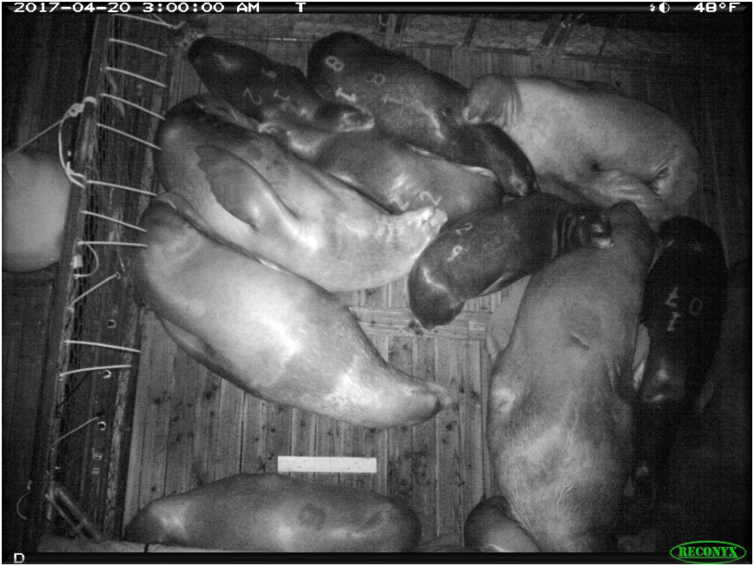
California Sea Lion Removal
Removal criteria
  Observed five days
  Observed eating a salmon
  Exposed to hazing
To date:
800 authorized for removal
270 Branded CSL
  15 sent to zoos/aquariums
  185 euthanized
  186 including U-605 (Captured in the Willamette, euthanized at BON.)
Notes:
Have to take into account that litigation has slowed down the process of removals. 2011 was a missed year.

